Slide 1

GlucoSense: AI-Powered Diabetes Prediction System
Early detection for better health outcomes.
by PRAKHAR MAURYA

Slide 2
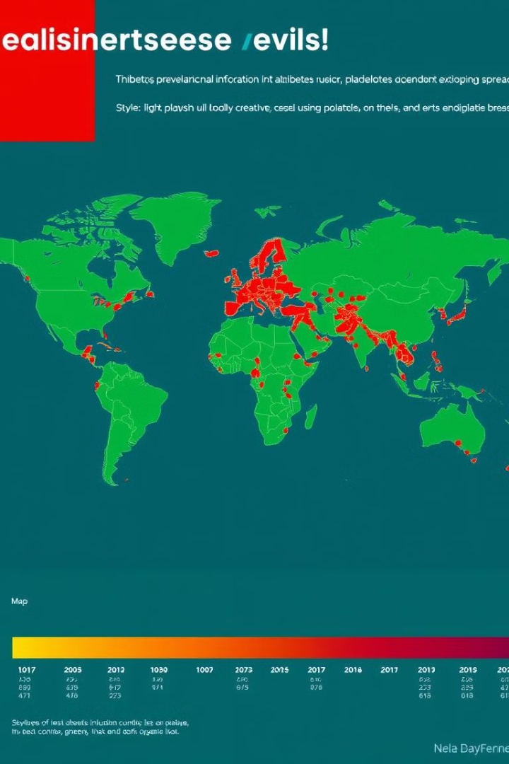
Introduction
Diabetes Impact
Early Detection
A global health issue with rising cases due to lifestyle changes.
Key to preventing complications and improving health outcomes.
Objective
Develop an AI-powered model to predict diabetes status using healthcare and lifestyle data.

Slide 3

Problem Statement & Objective
Growing Diabetes Cases
Need for Early Detection
The prevalence of diabetes has increased significantly over the last 15 years.
Early intervention can mitigate complications, leading to better patient outcomes.

Slide 4
Methodology Overview
1
Data Preparation
Clean and preprocess the dataset (missing values, outliers). Encode categorical data, normalize numerical features.
2
Feature Selection
Perform correlation analysis and use decision tree methods to identify key features.
3
Model Development
Train models like Logistic Regression, Random Forest, and Decision Trees. Optimize models using Cross-Validation and Hyperparameter Tuning.
4
Model Evaluation
Evaluate models on Accuracy, Precision, Recall, F1-Score, and AUC-ROC.
5
Deployment & Presentation
Deploy the best model and present key findings.

Slide 5
Data Overview & Preprocessing
Dataset Details
Preprocessing
520 records and 17 features (16 input, 1 output). Purpose: Predict diabetes using healthcare and lifestyle factors. Key Features: Age, Gender, Symptoms, Lifestyle Factors (e.g., Obesity, Muscle Stiffness).
No missing values found. 269 duplicate rows identified and removed. Categorical Encoding: Gender (Male = 1, Female = 0).

Slide 6
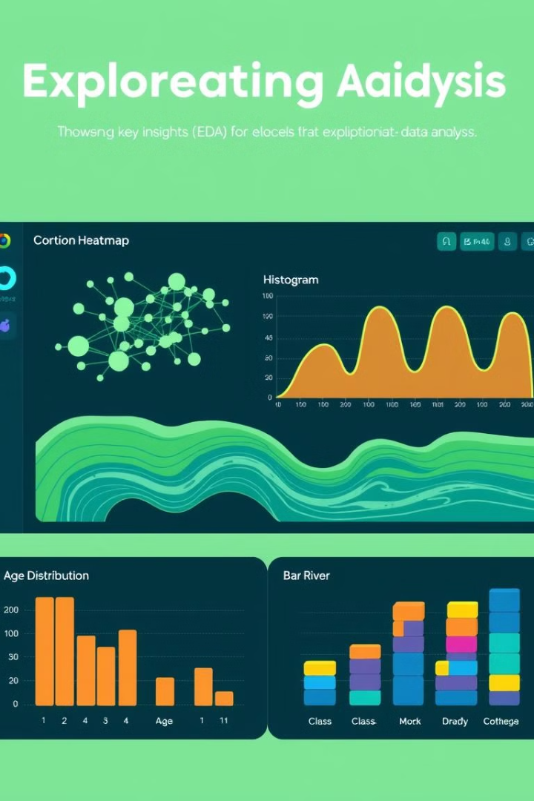
Exploratory Data Analysis (EDA)
Key Insights
Visualized distributions of Age, Gender, and other features. Explored correlations, e.g., Age vs. Class. Imbalance observed (more non-diabetic cases). Boxplots identified outliers in features like Age.

Slide 7
Feature Selection & Model Development
Feature Selection Insights
Model Training & Hyperparameters
Strong indicators of diabetes: Polyuria (0.62), Polydipsia (0.59). Moderate correlation: Polyuria and Polydipsia (0.52). Low correlation with Age, Alopecia, and Muscle Stiffness.
Random Forest: n_estimators=100, max_depth=None. Gradient Boosting: learning_rate=0.1, n_estimators=100. SVM: kernel='rbf', C=1.0. Logistic Regression: penalty='l2', C=1.0.

Slide 8
Model Evaluation & Results
0.99
1.00
Accuracy
ROC-AUC
0.08
0.06
Log Loss
Log Loss
Random Forest
Extra Trees
0.98
1.00
MCC
Precision/Recall/F1-Score

Slide 9
Conclusion & Next Steps
Conclusion
Next Steps
The AI-powered model accurately predicts diabetes status based on lifestyle and health data. Early intervention can significantly improve patient outcomes.
Further hyperparameter tuning. Real-time deployment via a user interface (Flask/Streamlit). Integrate more data features for better predictions.

